Slide 1
Accelerated Learning Initiative Nodejs with Express and and MongoDB

Slide 2
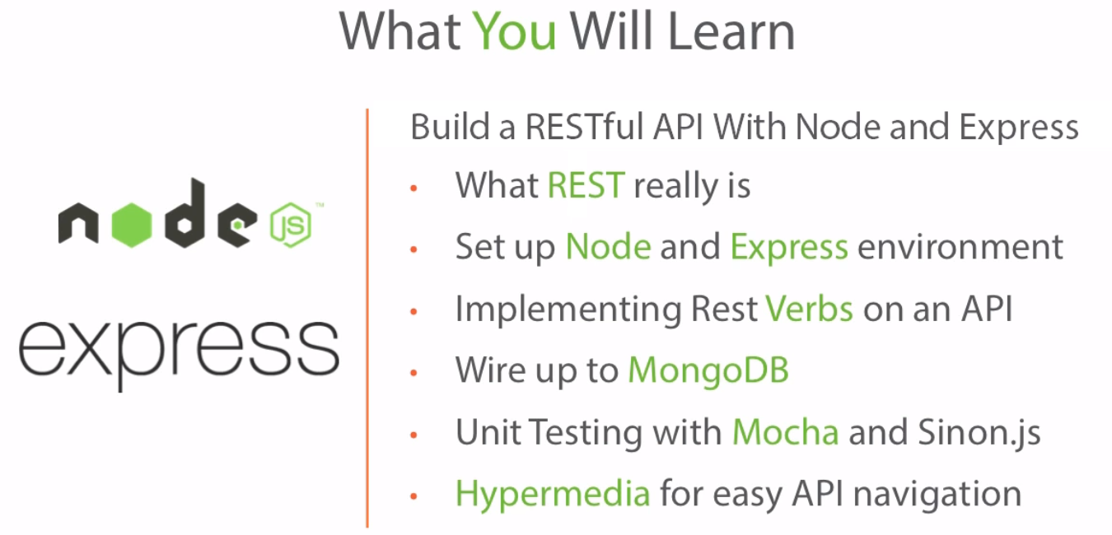
Agenda
Copyright © 2017 Accenture All rights reserved.

Slide 3
What is REST Anyway ?
REST (Representational State Transfer) is web standards based architecture and uses HTTP Protocol. A REST Server simply provides access to resources and REST client accesses and modifies the resources using HTTP protocol. REST uses various representations to represent a resource like text, JSON, and XML but JSON is the most popular one.
Why do we need RESTful Web Services?
REST is an architecture style for designing networked applications. REST is a lightweight alternative to mechanisms like RPC (Remote Procedure Calls) and Web Services (SOAP, WSDL, et al.). The World Wide Web itself, based on HTTP, can be viewed as an REST-based architecture. The entire modern web browsers are REST client. RESTful applications use HTTP methods (GET, POST, PUT, and DELETE) to perform CRUD operations.
Advantages:
Simple
Easy to use/implement
Easy to build
Uniform interface
The REST API is always independent of the type of platform or languages
Visible, reliable, and scalable
Copyright © 2017 Accenture All rights reserved.
Notes:
ReST respresents a series of constraints whenever a client talks to server , series of rules in the server for client to use to service

Slide 4

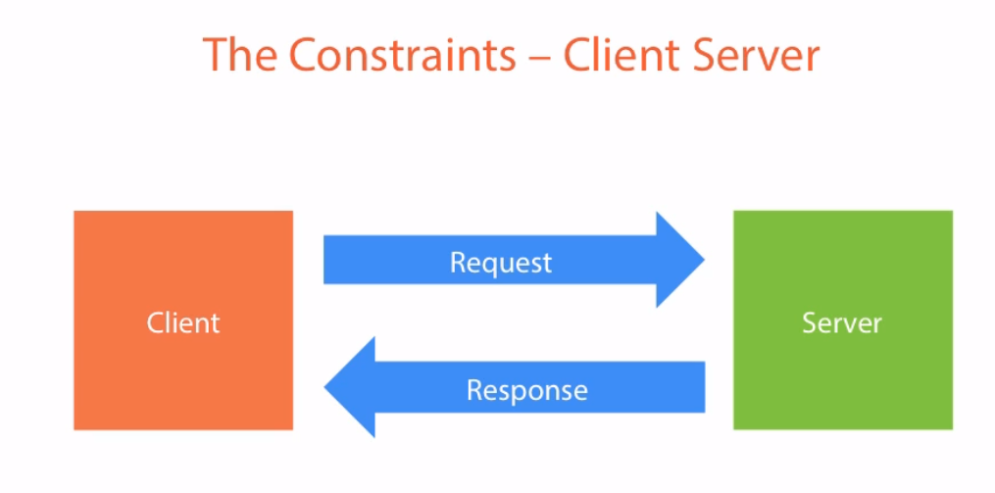
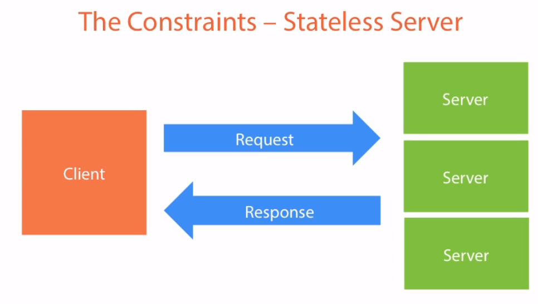
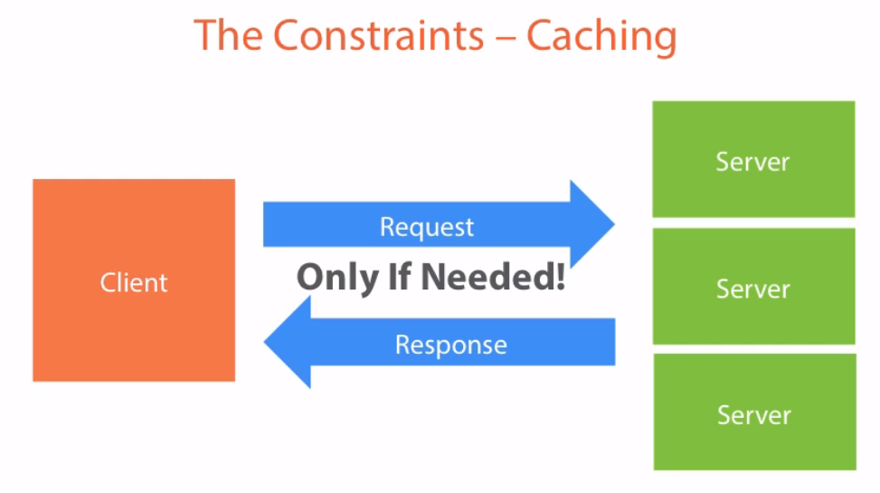
What is REST Anyway ?
Copyright © 2017 Accenture All rights reserved.
Notes:
ReST respresents a series of constraints whenever a client talks to server , series of rules in the server for client to use to service
Constraint
Client sends request and server sends response
As load increases we add more servers , now we get into situation where server 1 may contain some info of client which doesn’t get transferred to server 2. Don’t get into this situation. Each request should have the all info to process the request. Example..
Caching – send the data to client with the info that how long the data is valid for and not to come back to server over and over again

Slide 5
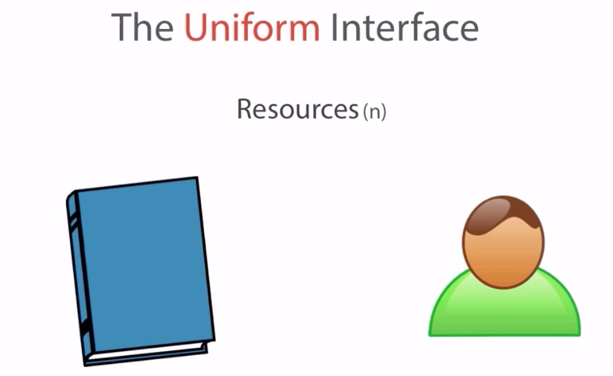


Constraint.. – The Uniform Interface NOUNS ands VERBS
Copyright © 2017 Accenture All rights reserved.
Notes:
We will be dealing with a resource(s) , nouns and not verbs like authorize or login. For this project we will deal with books and authors

Slide 6
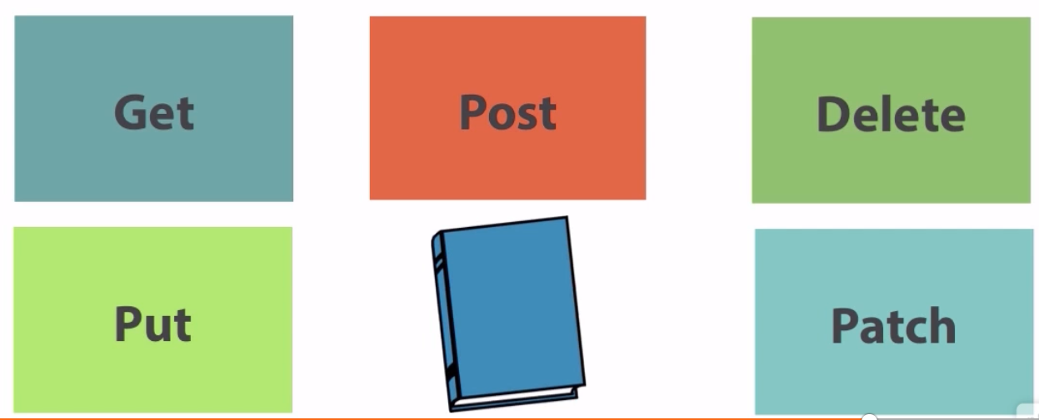
Constraint.. – The Uniform Interface NOUNS ands VERBS
Best practices for defining REST APIs
http://www.vinaysahni.com/best-practices-for-a-pragmatic-restful-api
Copyright © 2017 Accenture All rights reserved.
Notes:
VERBS

Slide 7
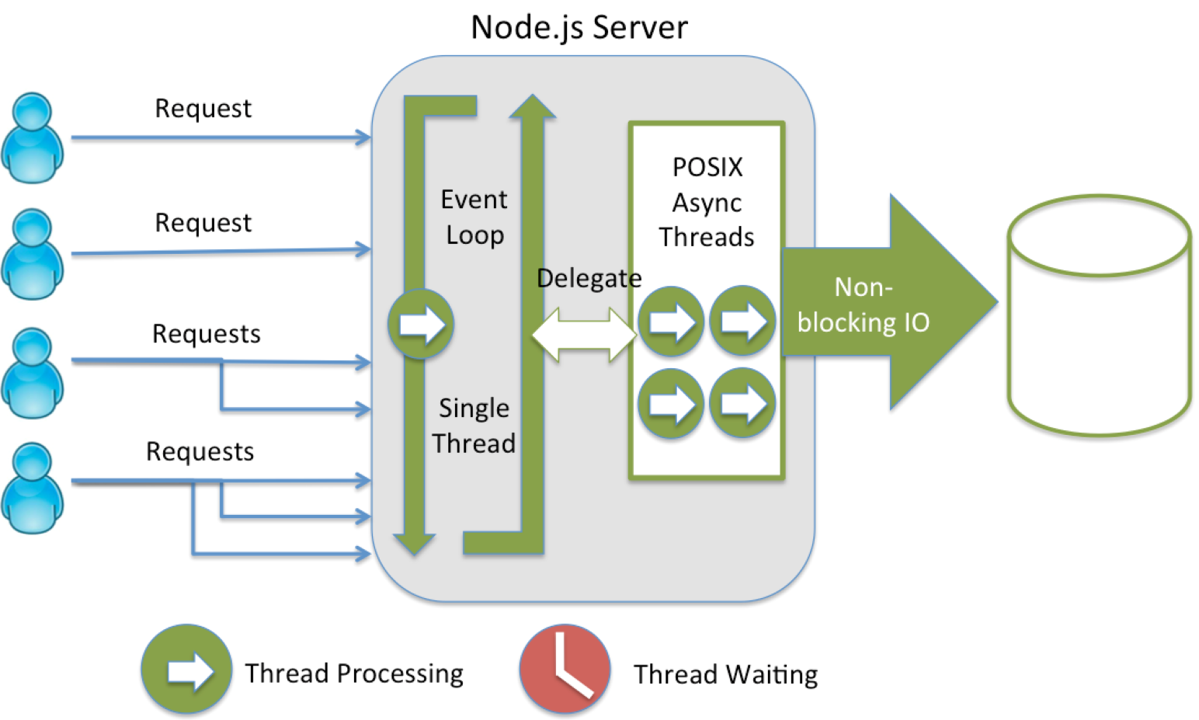
Why opt Node JS for building RESTful APIS?
Node.js is a powerful JavaScript framework built on Google Chrome’s JavaScript V8 Engine. It is used to develop I/O intensive web applications like video streaming sites, single-page applications, etc. Node.js is open source and used by thousands of developers around the world.
Advantages:
Quick & easy development
High performance
Run on single thread to handle multiple concurrent requests
Easy to write API and interaction code
Streaming support
Monitoring possibilities
Authentication support
Lightweight, fast, and scalable
Copyright © 2017 Accenture All rights reserved.
Notes:
ReST respresents a series of constraints whenever a client talks to server , series of rules in the server for client to use to service

Slide 8
Javascript event loop architecture and
Why prefer nodejs over .NET or java
https://www.infoworld.com/article/2975233/javascript/why-node-js-beats-java-net-for-web-mobile-iot-apps.html
http://www.dotnettricks.com/learn/nodejs/advantages-and-limitations-of-nodejs
Event Loop architecture reference
https://www.youtube.com/watch?v=8aGhZQkoFbQ
https://blog.carbonfive.com/2013/10/27/the-javascript-event-loop-explained/
Copyright © 2017 Accenture All rights reserved.
Notes:
ReST respresents a series of constraints whenever a client talks to server , series of rules in the server for client to use to service

Slide 9
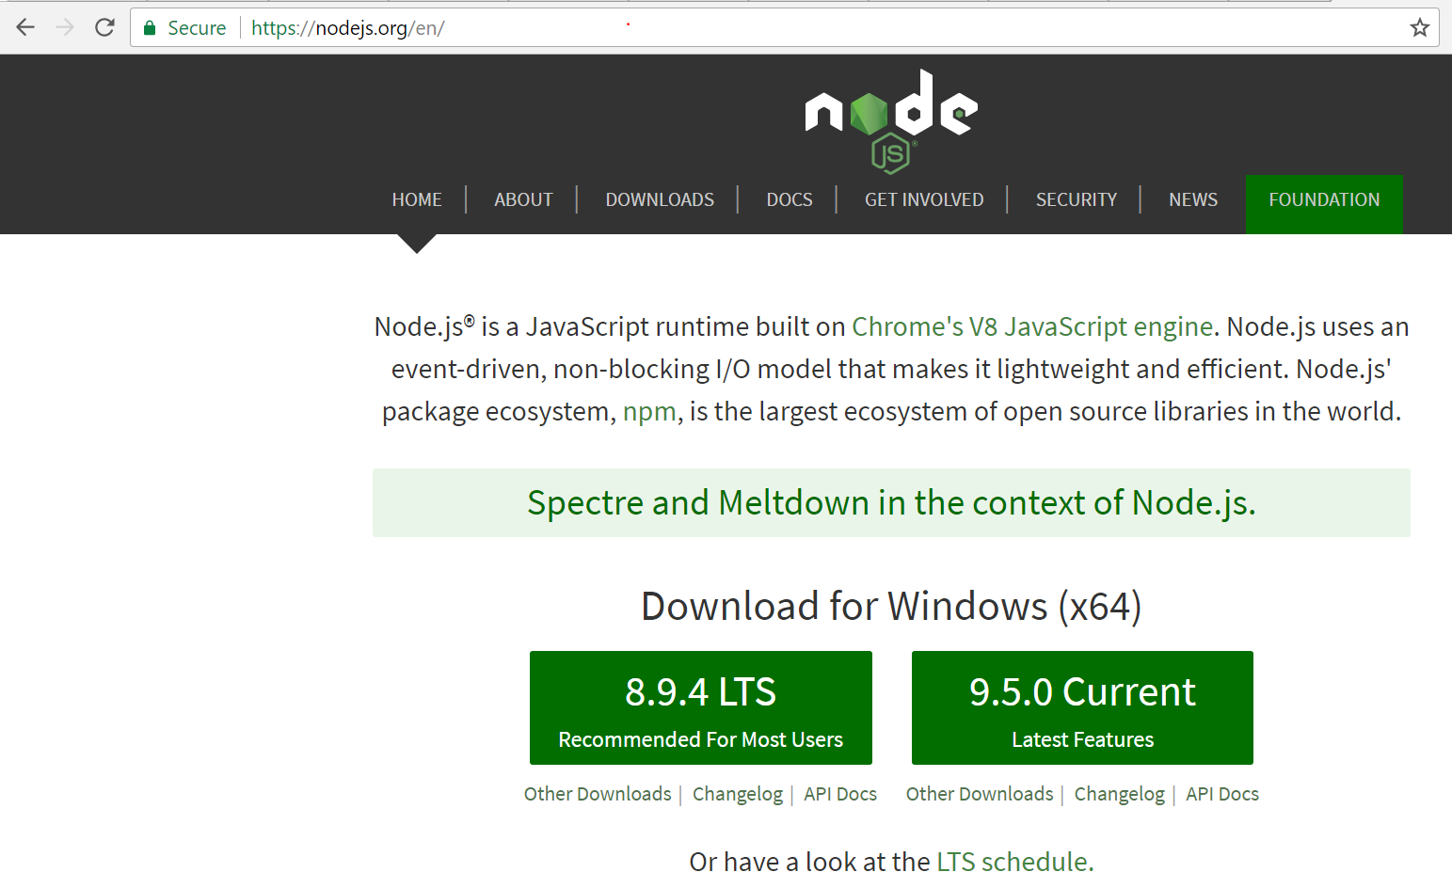
Start - Installation
STEP1 – Install node from nodejs.org
Copyright © 2017 Accenture All rights reserved.
Notes:
ReST respresents a series of constraints whenever a client talks to server , series of rules in the server for client to use to service

Slide 10
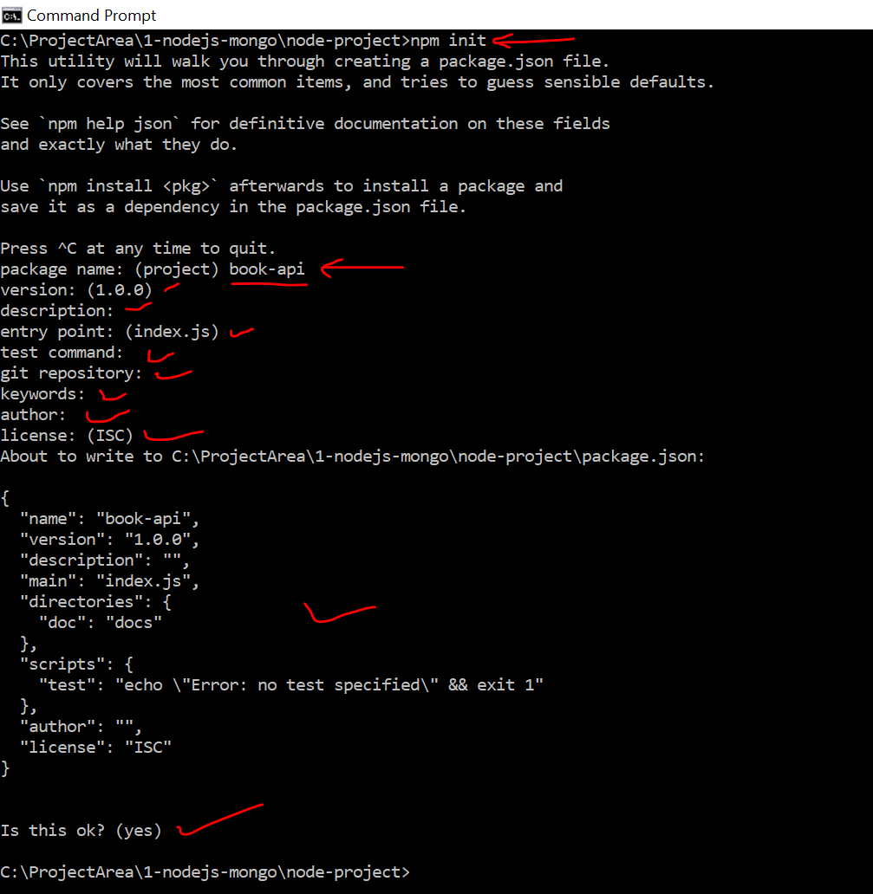
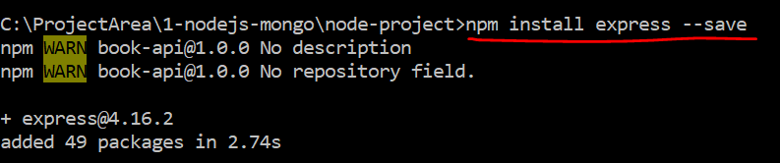
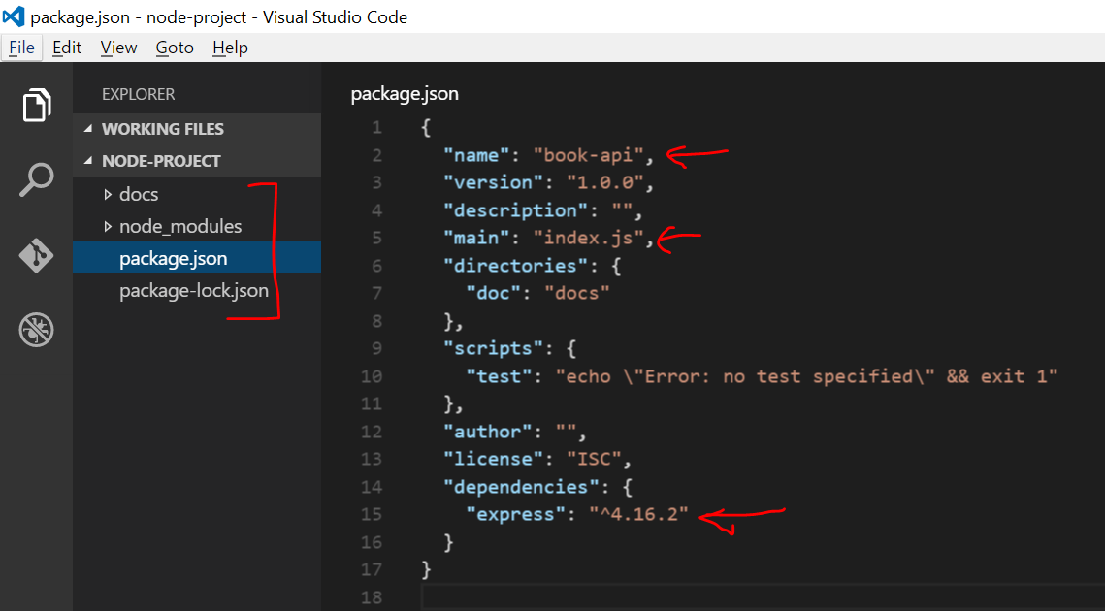
Start – Installation and start a new API project (Continued..)
STEP2 – npm init from any project folder
STEP3 – Install Express (Notice package.json after the command)
STEP4 – Open the code is editor and notice..
Copyright © 2017 Accenture All rights reserved.
Notes:
Express.js, or simply Express, is a web application framework for Node.js, released as free and open-source software under the MIT License. It is designed for building web applications and APIs.^{[2]} It is in fact the standard server framework for Node.js.^{[3]}

Slide 11
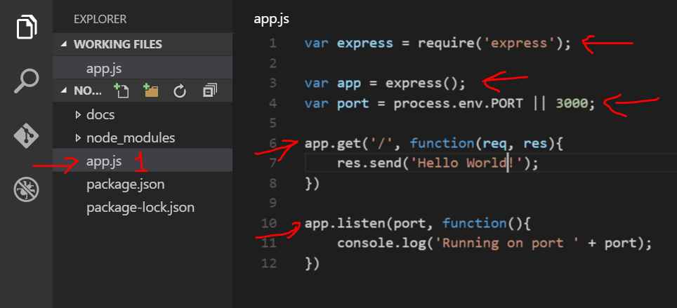
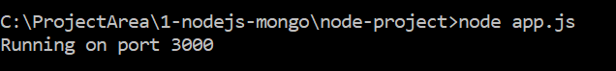
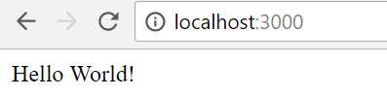
Start – Simple “Hello World”
Copyright © 2017 Accenture All rights reserved.
Notes:
Reference to express
Setup a port
App.get to root , if someone goes to root return them a hello world message
App.listen with a message

Slide 12
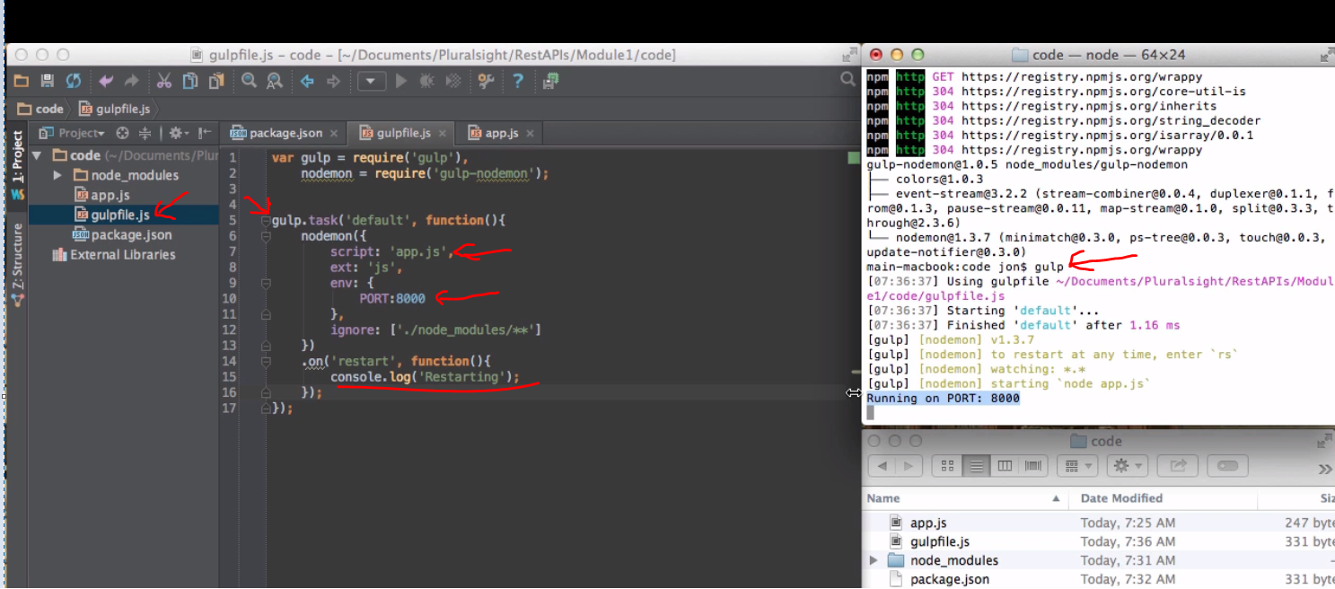
Gulp – The task runner ( SKIP and talk later)
Copyright © 2017 Accenture All rights reserved.

Slide 13
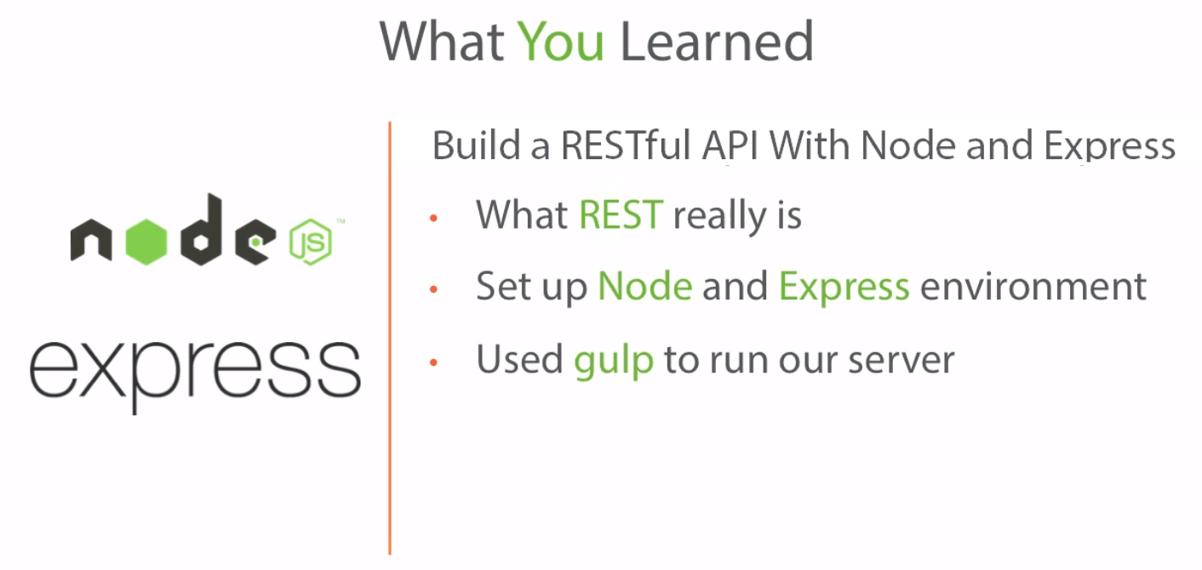
Checkpoint
Copyright © 2017 Accenture All rights reserved.
Notes:
ReST respresents a series of constraints whenever a client talks to server , series of rules in the server for client to use to service

Slide 14
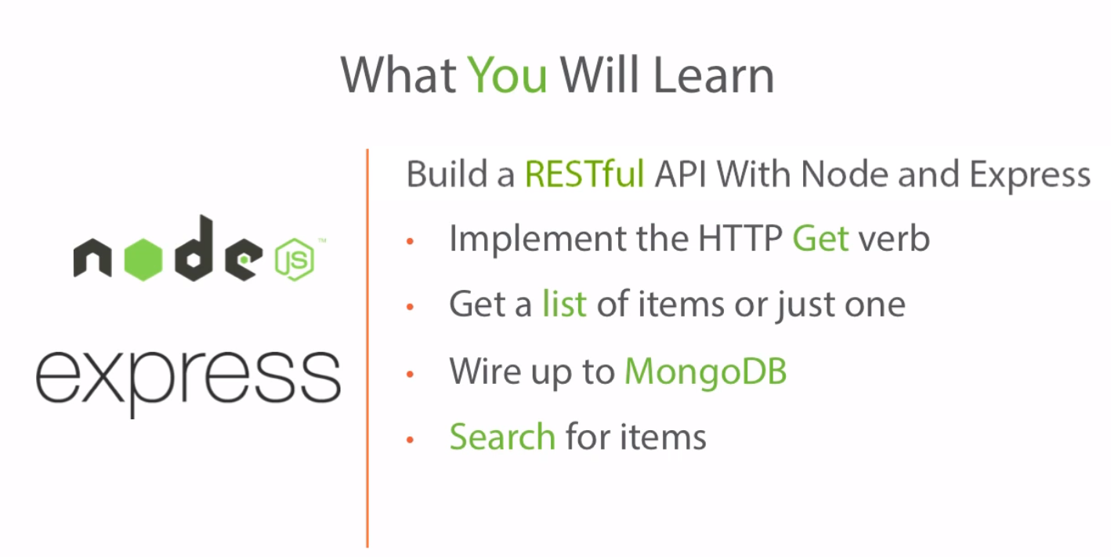
Module -2
Copyright © 2017 Accenture All rights reserved.
Notes:
ReST respresents a series of constraints whenever a client talks to server , series of rules in the server for client to use to service

Slide 15
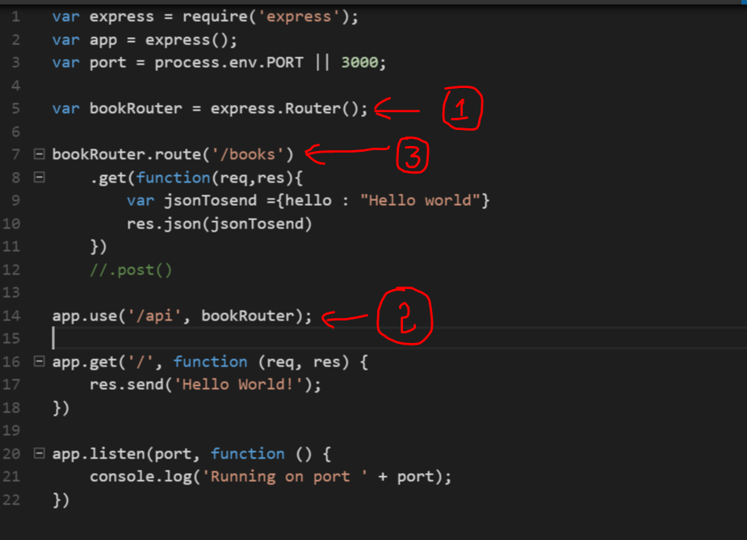
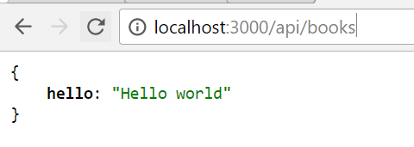
Simple - GET API using router
Copyright © 2017 Accenture All rights reserved.
Notes:
Install jsonview plugin from chrome store

Slide 16
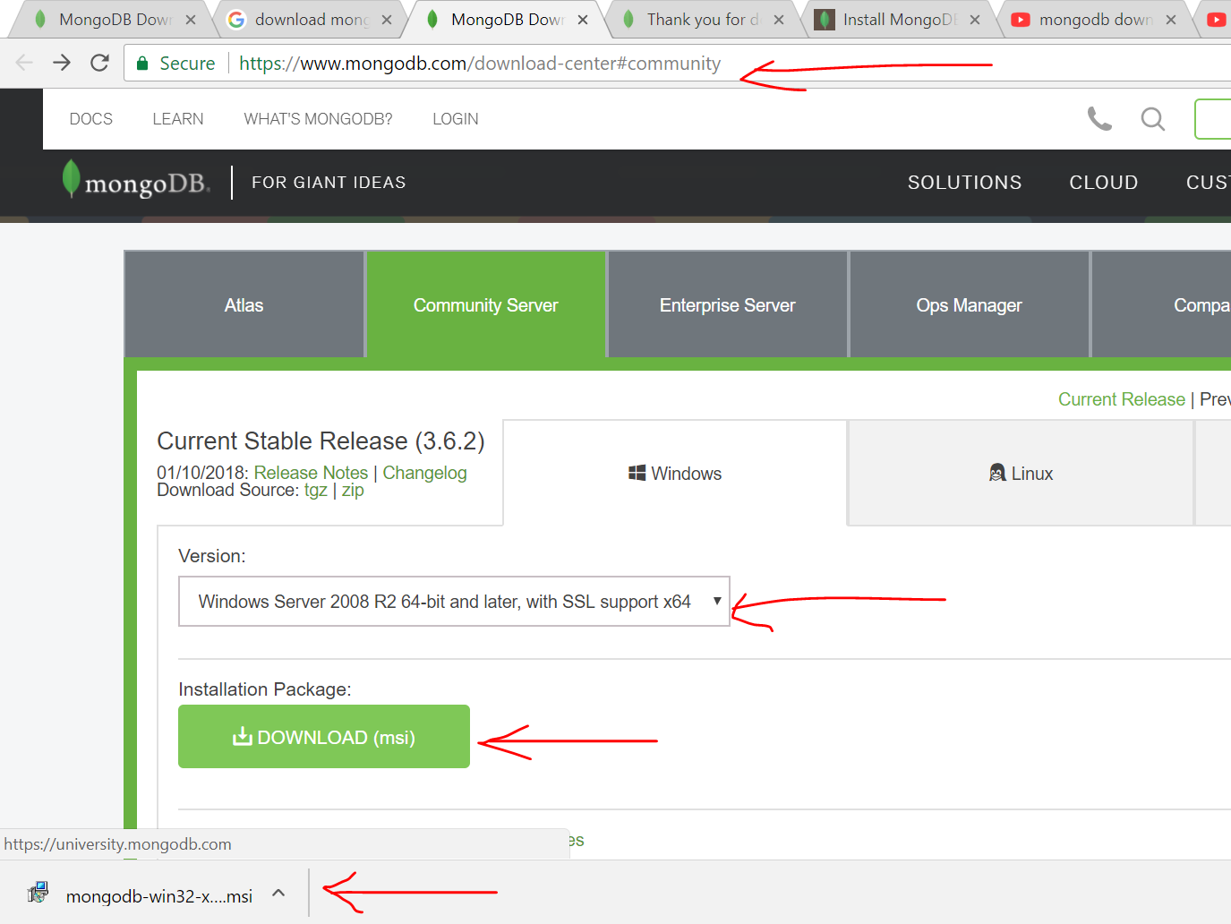
Wire-up Mongo DB
STEP1 : download and install MongoDB
STEP2 : MongoDB requires a data directory to store all data. MongoDB’s default data directory path is the absolute path \data\db on the drive from which you start MongoDB. Create this folder by running the following command in a Command Prompt:
C: \md \data\db
STEP3 : Start MongoDB by running command "C:\Program Files\MongoDB\Server\3.6\bin\mongod.exe"
STEP4 : To connect to MongoDB through the ~bin.mongo.exe shell, open another Command Prompt.
"C:\Program Files\MongoDB\Server\3.6\bin\mongo.exe"
STEP5 : Install MongoDB Compass
Copyright © 2017 Accenture All rights reserved.
Notes:
Mongoose is a MongoDB object modeling tool designed to work in an asynchronous environment.

Slide 17
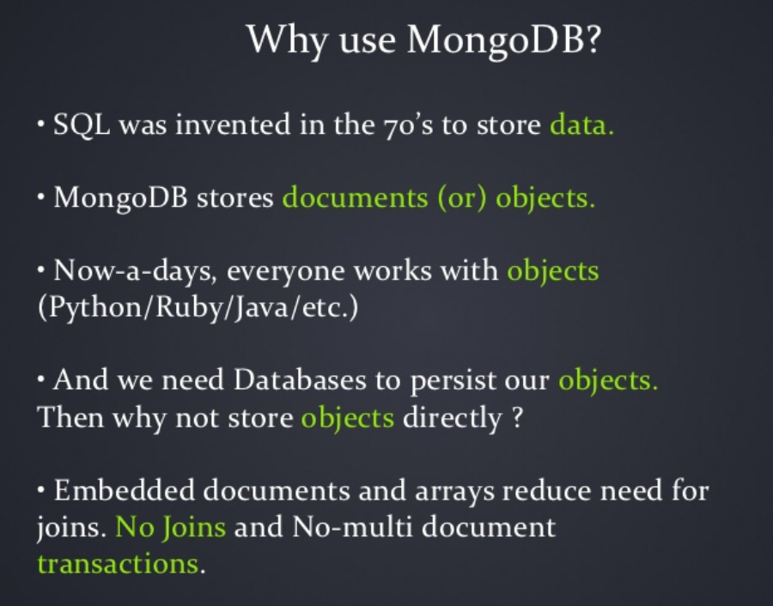
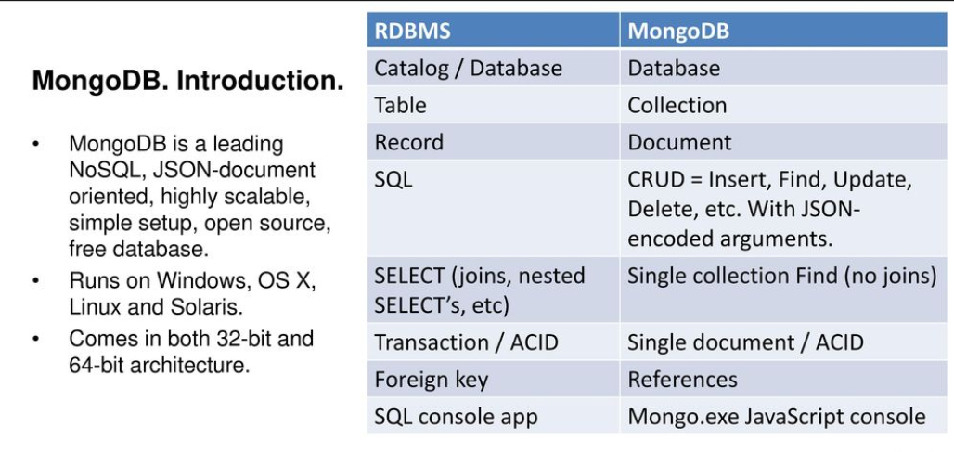
MongoDB - Overview
MongoDB is a free and open-source cross-platform document-oriented database program. Classified as a NoSQL database program, MongoDB uses JSON-like documents with schemas. MongoDB is developed by MongoDB Inc., and is published under a combination of the GNU Affero General Public License and the Apache License.
Copyright © 2017 Accenture All rights reserved.

Slide 18
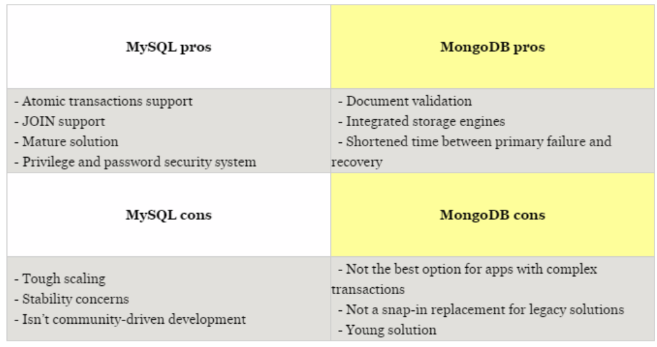
RDBMS Vs MongoDB
Copyright © 2017 Accenture All rights reserved.

Slide 19
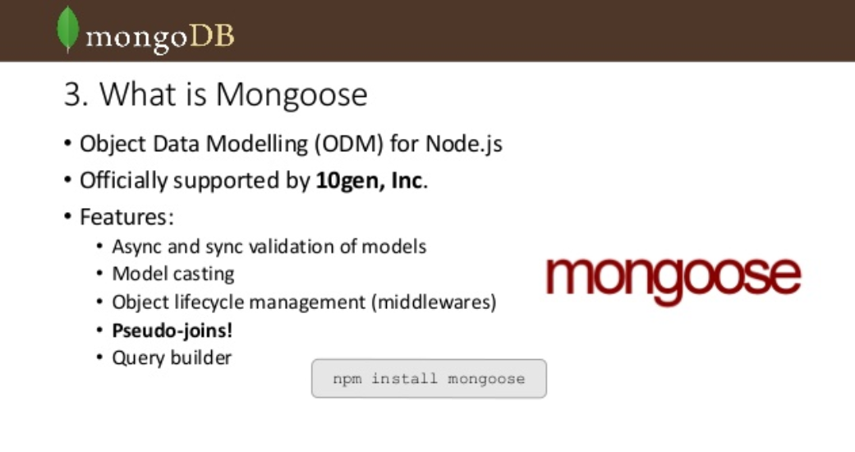
Mongoose
Copyright © 2017 Accenture All rights reserved.
Notes:
Mongoose is a MongoDB object modeling tool designed to work in an asynchronous environment.
Like Entity framework , takes data from mongo and converts it into json to be used in our application

Slide 20
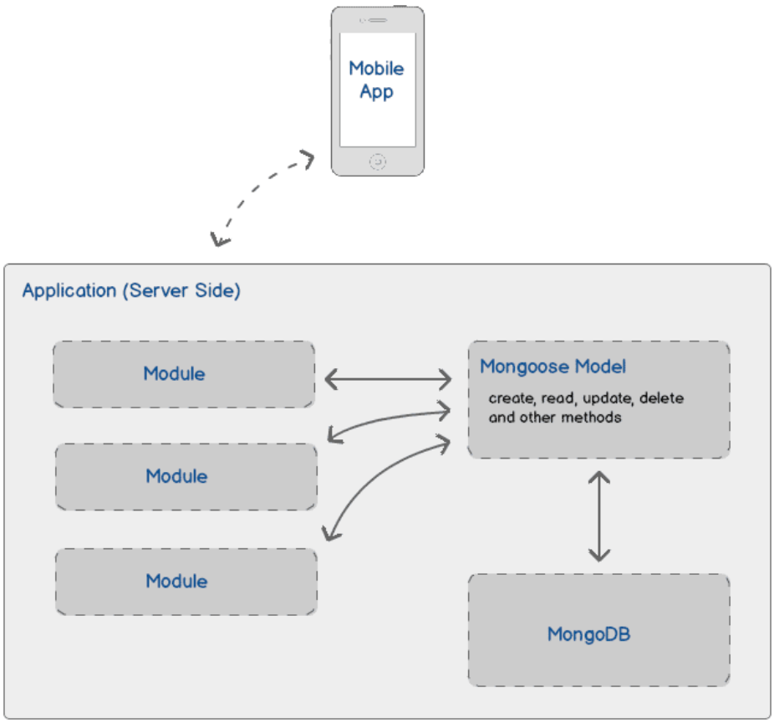
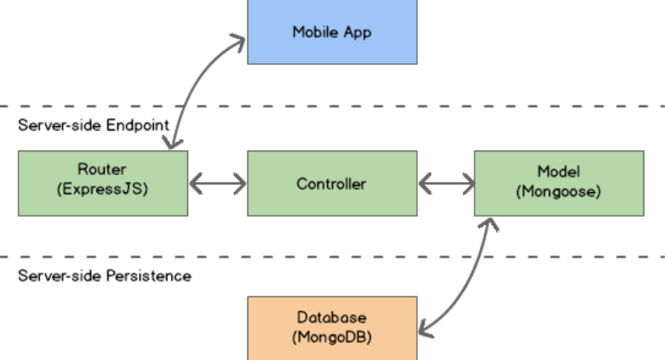
Mongoose
Install Mongoose using below command
Copyright © 2017 Accenture All rights reserved.

Slide 21
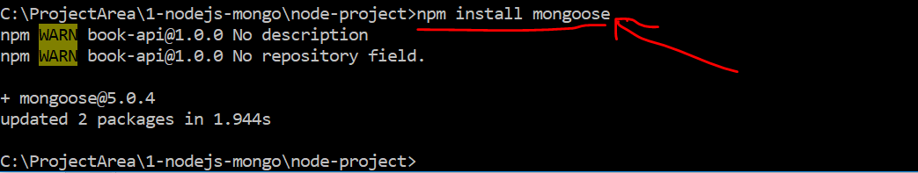
GET API using Books model and mongoose
Install Mongoose using below command
Copyright © 2017 Accenture All rights reserved.

Slide 22
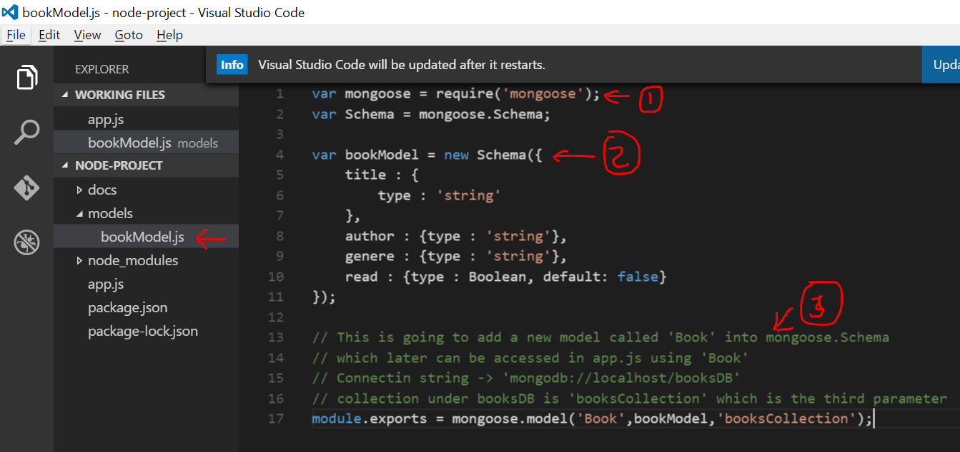
Add a Model
Copyright © 2017 Accenture All rights reserved.

Slide 23
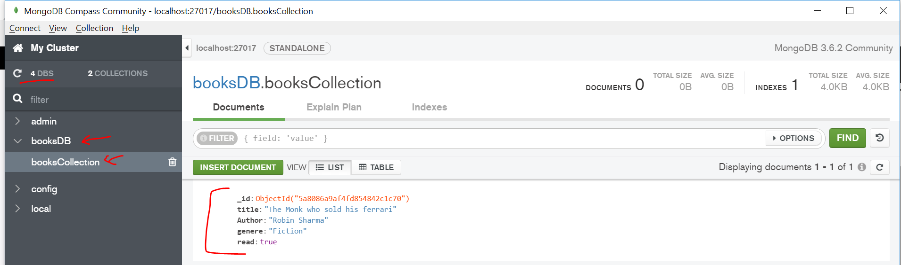
Add data into Mongo DB from Backend using Compass or Robomongo
Copyright © 2017 Accenture All rights reserved.

Slide 24
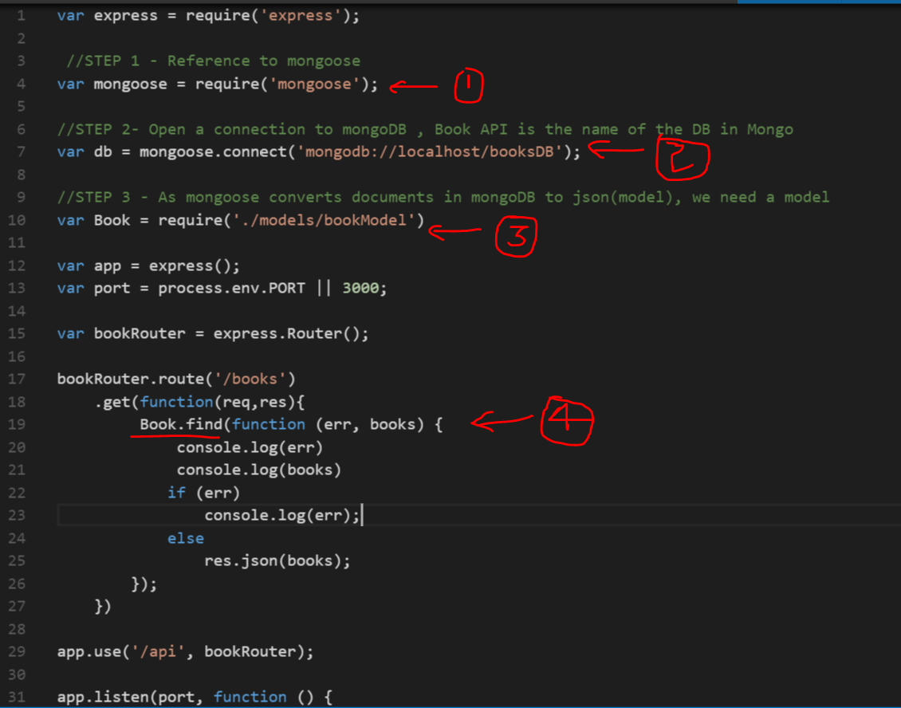
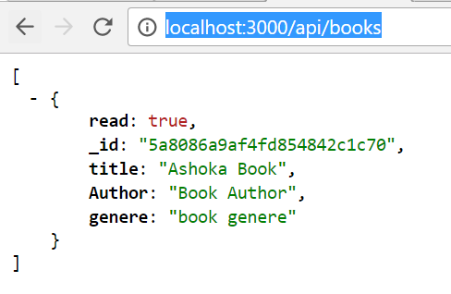
Update App.js and execute GET operation
Copyright © 2017 Accenture All rights reserved.

Slide 25
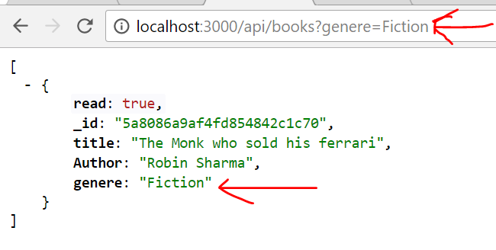
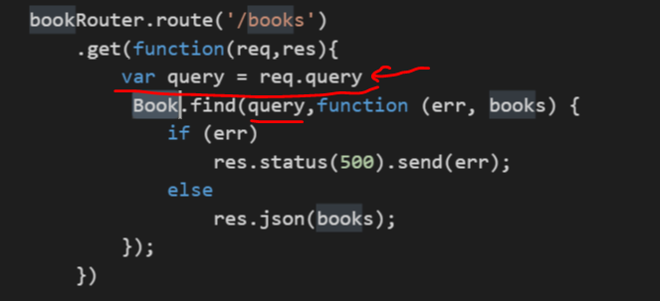
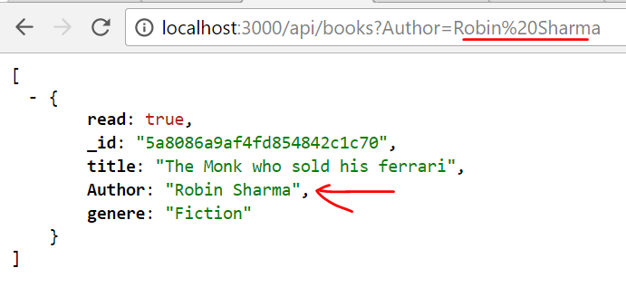
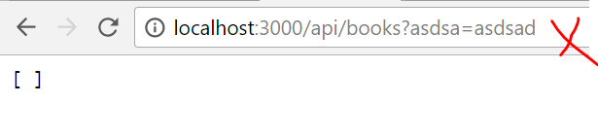
GET Operation with filtering option
Express converts query string parameter into below json query
Req.query = { genere : ‘Fiction’}
Copyright © 2017 Accenture All rights reserved.

Slide 26
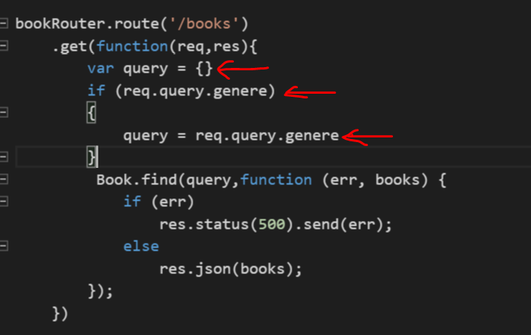
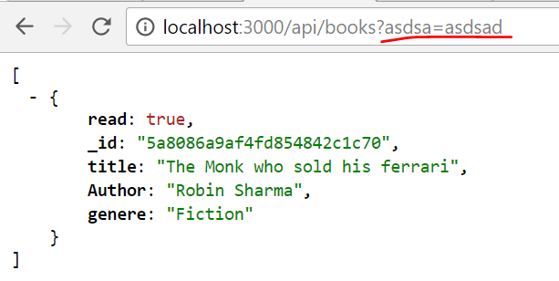
GET Operation with filtering name validation
Copyright © 2017 Accenture All rights reserved.

Slide 27
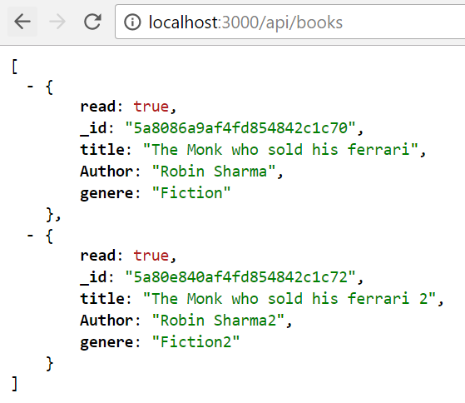
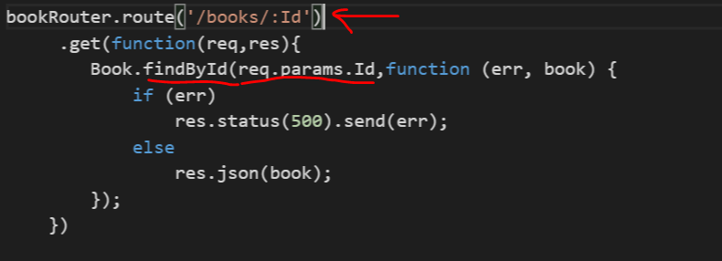
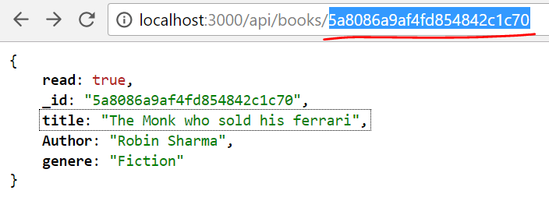
GET Operation to get a single item
Copyright © 2017 Accenture All rights reserved.

Slide 28
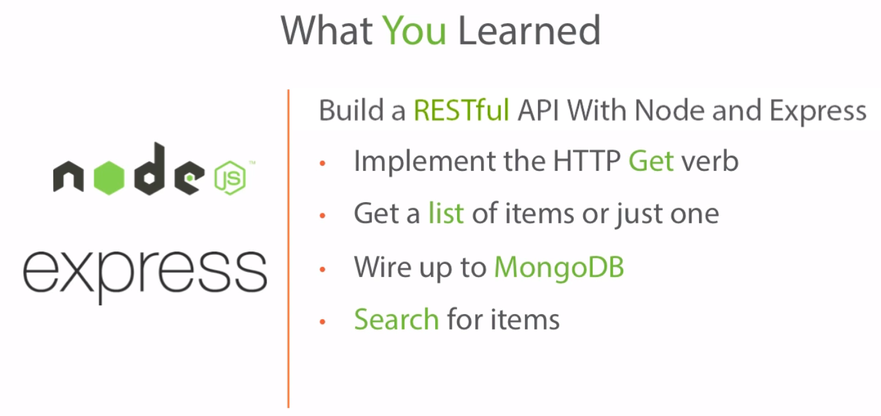
Checkpoint
Copyright © 2017 Accenture All rights reserved.

Slide 29
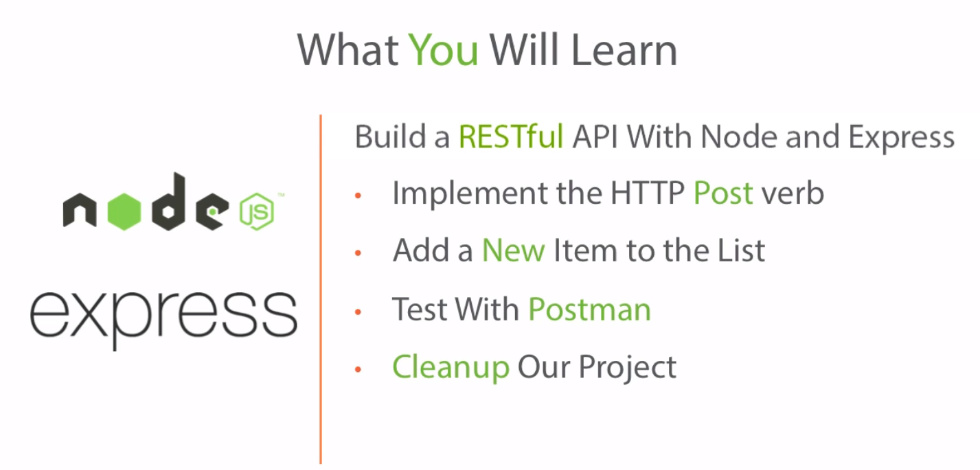
Posting Data
Copyright © 2017 Accenture All rights reserved.

Slide 30
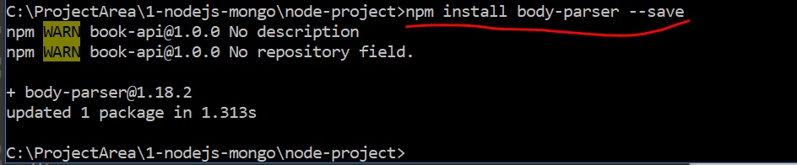
Install body parser to read post data
Copyright © 2017 Accenture All rights reserved.

Slide 31
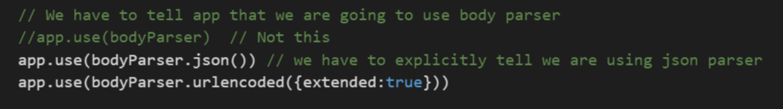
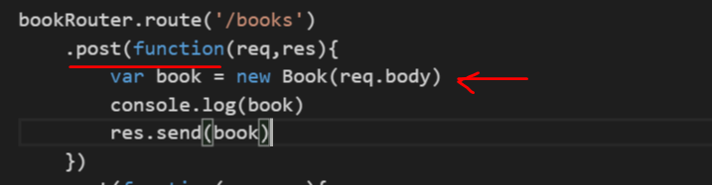
POST API
Copyright © 2017 Accenture All rights reserved.

Slide 32
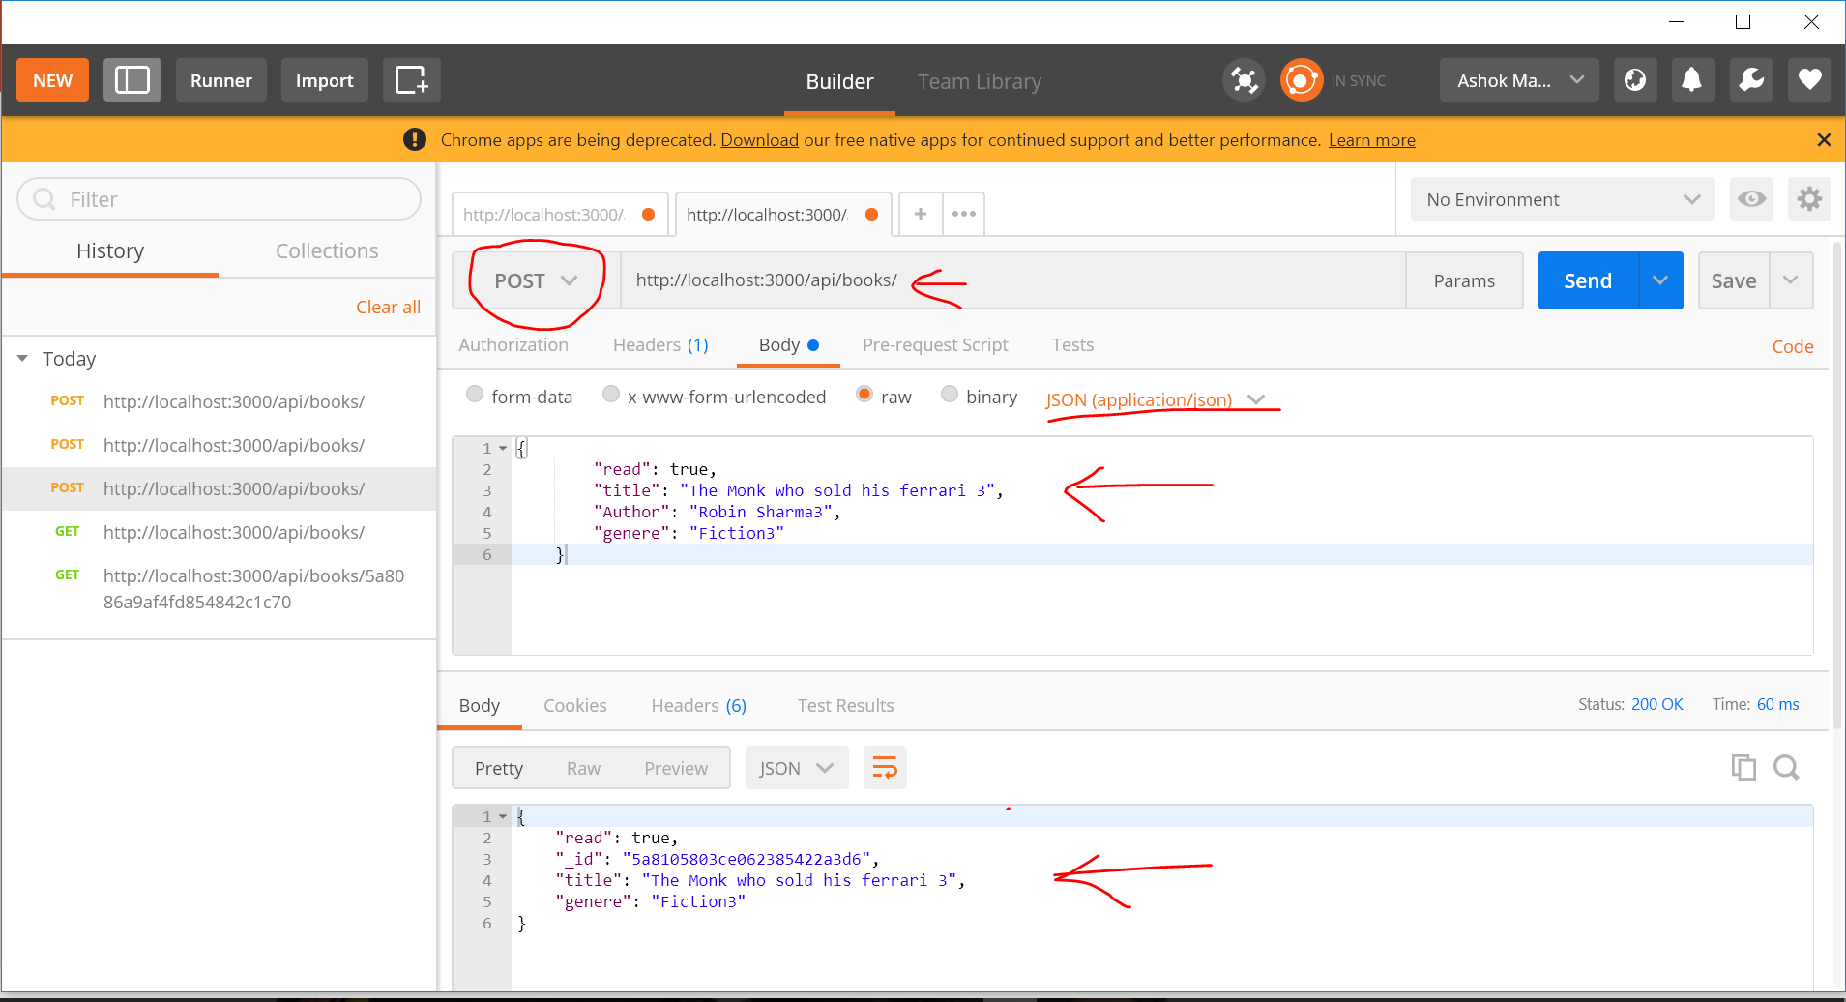
POST – using Postman the chrome extension or SOAPUI
Copyright © 2017 Accenture All rights reserved.

Slide 33
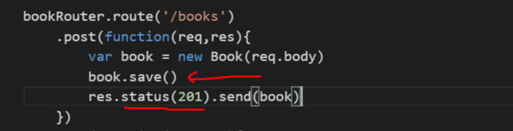
Post API – Save to MongoDB
Copyright © 2017 Accenture All rights reserved.

Slide 34
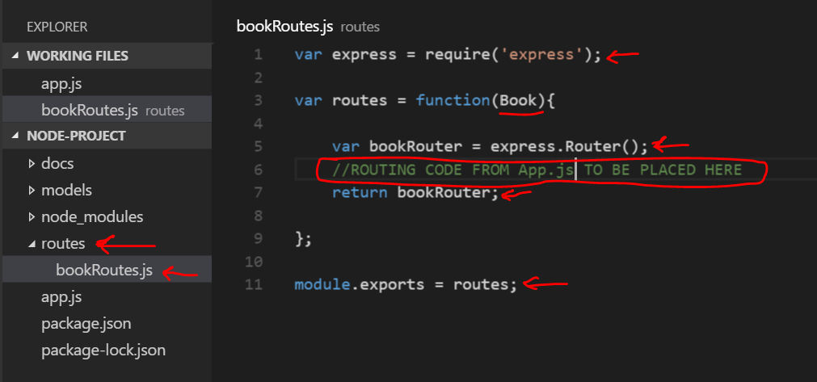
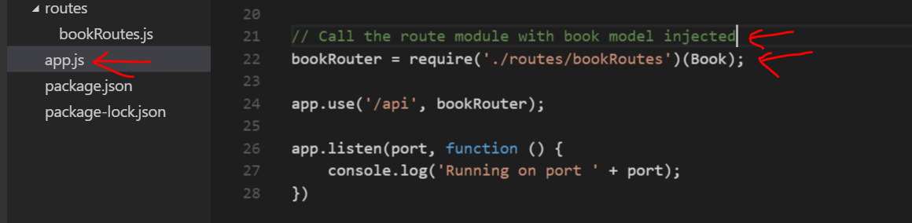
Code refactor and inject book model
Copyright © 2017 Accenture All rights reserved.

Slide 35
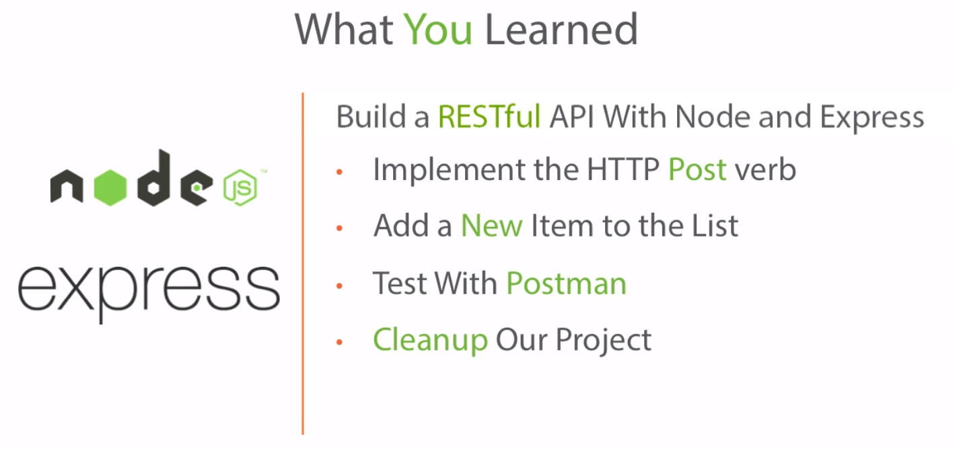
Checkpoint
Copyright © 2017 Accenture All rights reserved.

Slide 36

PUT and PATCH
Copyright © 2017 Accenture All rights reserved.

Slide 37


PUT API
Copyright © 2017 Accenture All rights reserved.

Slide 38


PATCH API
Copyright © 2017 Accenture All rights reserved.

Slide 39


Refactor with middleware
Copyright © 2017 Accenture All rights reserved.
Notes:
As we are repeating the findById code in GET , PUT and POST , we can refactor that code into a middleware
Refactor all APIs using the above code

Slide 40

Remove API
Copyright © 2017 Accenture All rights reserved.

Slide 41
<…>
Copyright © 2017 Accenture All rights reserved.

Slide 42
<…>
Copyright © 2017 Accenture All rights reserved.

Slide 43
<…>
Copyright © 2017 Accenture All rights reserved.

Slide 44
<…>
Copyright © 2017 Accenture All rights reserved.

Slide 45
<…>
Copyright © 2017 Accenture All rights reserved.

Slide 46
<…>
Copyright © 2017 Accenture All rights reserved.

Slide 47
<…>
Copyright © 2017 Accenture All rights reserved.

Slide 48
<…>
Copyright © 2017 Accenture All rights reserved.

